Slide 1

A gamified introduction to Python Programming Lecture 14 Everything about strings
Matthieu DE MARI – Singapore University of Technology and Design

Slide 2

Outline (Chapter 14)
What is a string? How are they related to lists?
How to index, slice and traverse a string?
What is the immutability property of strings?
What are common booleans on strings?
A complete description of printing and formatting with strings.
How ton convert strings to lists and vice-versa?
What are more advanced operations on strings, such as splitting, stripping, character checking, sorting, etc.? (RTFM!)

Slide 3
From lists to strings
Important note: Lists and strings behave in a very similar way.
Lists: multiple elements between square brackets, separated by commas
Strings: multiple characters between single or double quotes (‘, “), without any separators.
Strings are roughly the same thing as a list of single characters.
string = “Hello”
equivalent_list = [“H”, “e”, “l”, “l”, “o”]
Great news: This means that most functions, methods and operators working on lists and seen earlier will work on strings as well!
(Except for one minor difference, to be discussed later…)

Slide 4
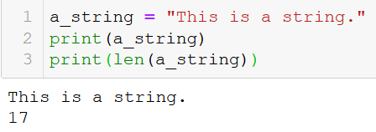
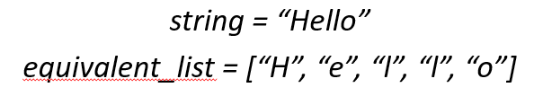
Length of a string
Definition (length of a string):
The length of a string is simply defined as the number of characters in the string.
This would be the same as the length of the equivalent list containing all single characters.
This is obtained, as before via the len() function.
Spaces and special characters count as characters!

Slide 5
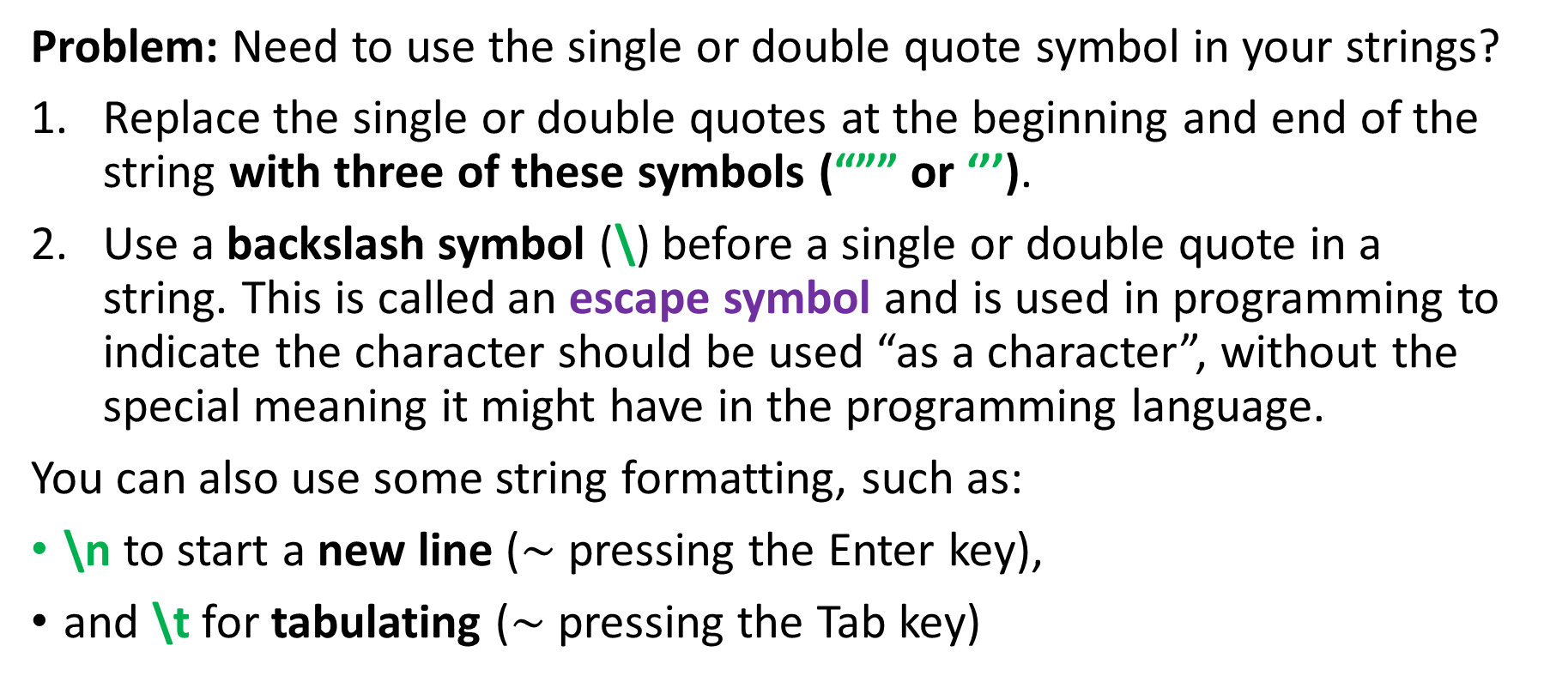
Using triple quotes and string formatting (\)
Problem: Need to use the single or double quote symbol in your strings?
Replace the single or double quotes at the beginning and end of the string with three of these symbols (“”” or ‘’’).
Use a backslash symbol (\) before a single or double quote in a string. This is called an escape symbol and is used in programming to indicate the character should be used “as a character”, without the special meaning it might have in the programming language.
You can also use some string formatting, such as:
\n to start a new line ($\sim$ pressing the Enter key),
and \t for tabulating ($\sim$ pressing the Tab key)

Slide 6
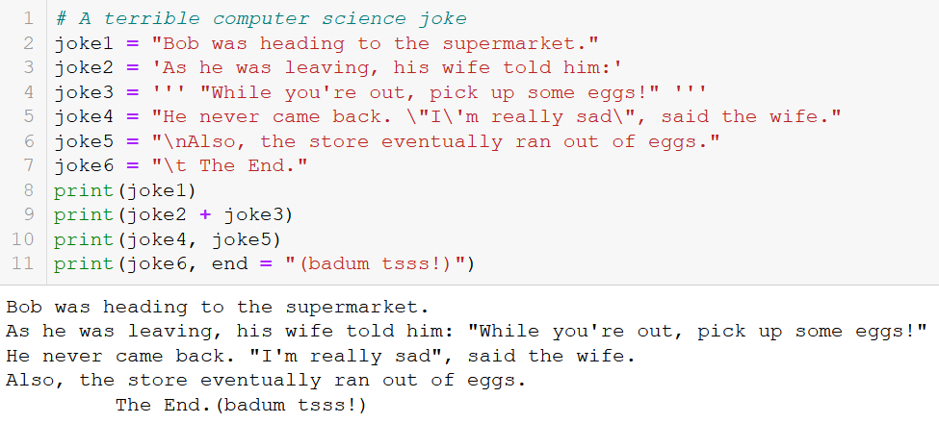
Using triple quotes and string formatting (\)

Slide 7
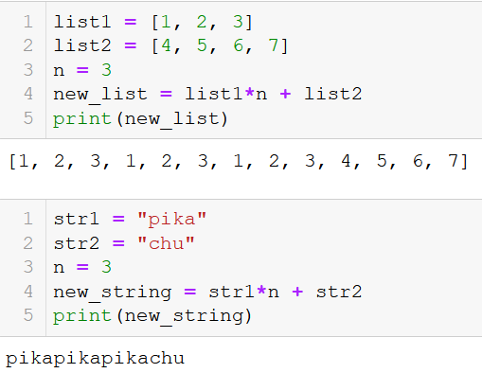
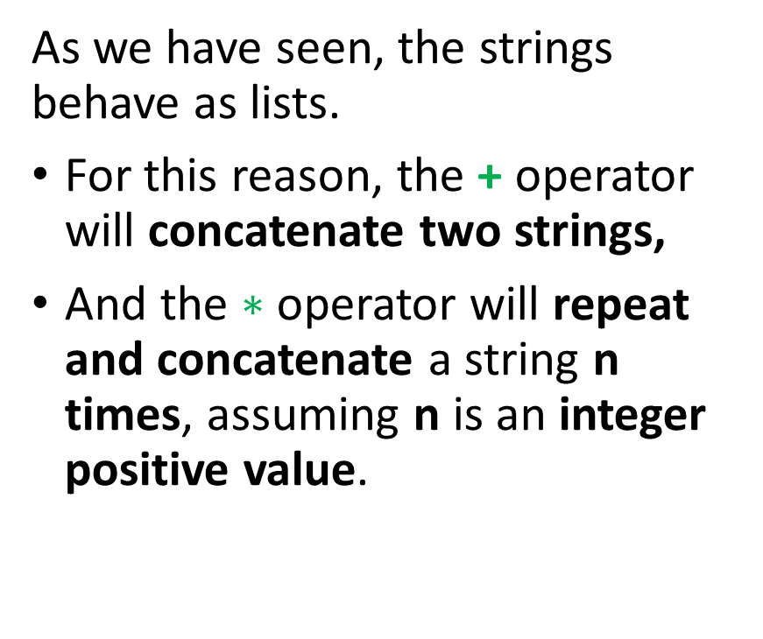

The + and $∗$ operators on strings
As we have seen, the strings behave as lists.
For this reason, the + operator will concatenate two strings,
And the $∗$ operator will repeat and concatenate a string n times, assuming n is an integer positive value.

Slide 8
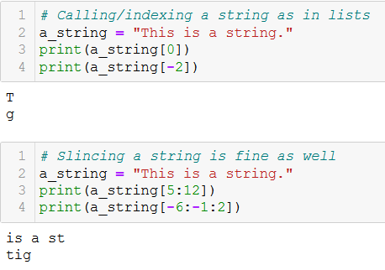
Indexing and slicing a string
As with lists, you can
index a string, by using the bracket notation [] on a list. It returns the character at the index position.
slice a string, by using the bracket notation [] on a list. It returns the substring with specified indexes.
As before, it helps to visualize the string as a list of characters.

Slide 9
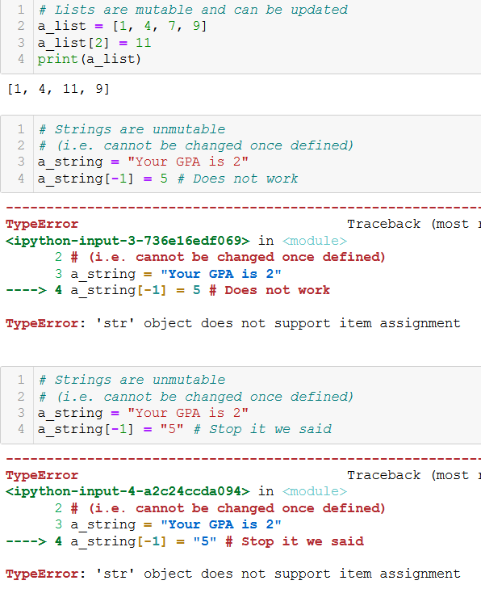
Immutable types
Definition (The immutability property of strings):
A major difference between lists and strings, however, is that strings are an immutable type.
Immutable means that you can not modify some or parts of its elements/characters, by using the bracket notation, as you would with lists.
Operation s[i] = “c” is not valid!

Slide 10
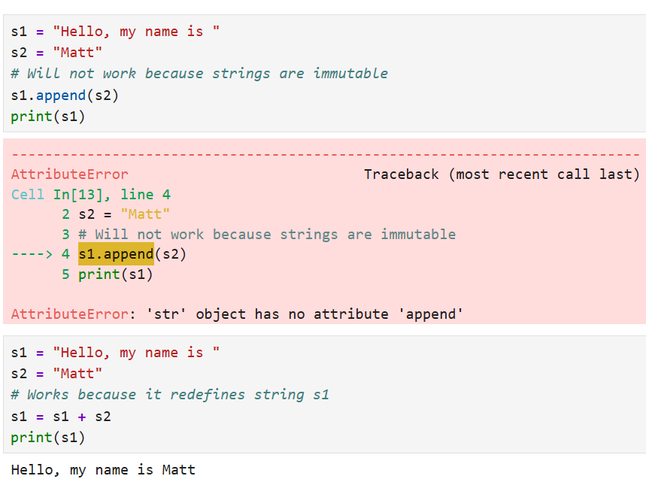
Immutable types
Note: the immutability property of strings also means that list functions and methods that would normally alter elements of the strings will also not work.
For instance, it is not possible to use append() on strings as this would modify the existing list of characters of the string.
There are workarounds, such as s1 = s1 + s2, which do not break the immutability property.

Slide 11
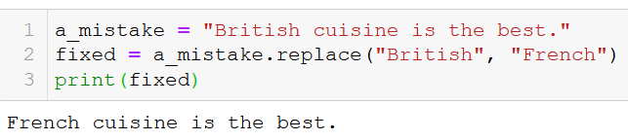
Replacing parts of a string
Instead, the strings come with a replace() method.
Its two parameter are strings s1 and s2 and the method is applied on a third string s3.
We need to catch the output, which is a new string, consisting of the third string s3, where the substring s1 has been replaced with s2.
The replace() method replaces all occurrences of s1 in s3 with s2.

Slide 12
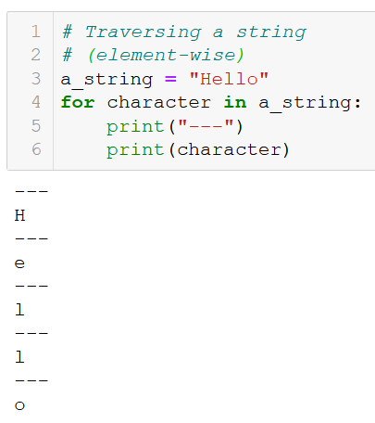
Traversing a string
Because strings are roughly the same things as lists, they can be traversed using a for loop,
Element-wise,

Slide 13
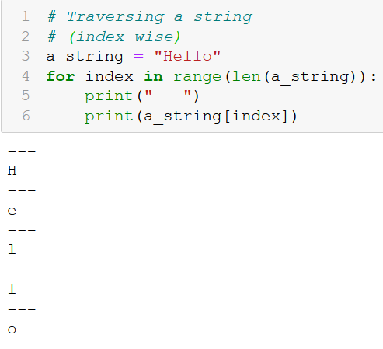
Traversing a string
Because strings are roughly the same things as lists, they can be traversed using a for loop,
Element-wise,
Index-wise,

Slide 14

Traversing a string
Because strings are roughly the same things as lists, they can be traversed using a for loop,
Element-wise,
Index-wise,
Index- and element-wise with enumerate.
(Everything else, such as zip, nested loops, etc. also works!)

Slide 15
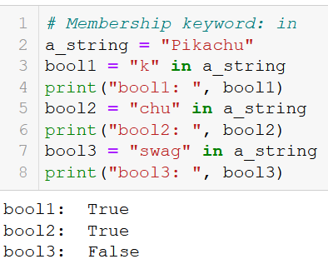
The in keyword
Membership operator in strings: As with lists, the in keyword can be used to check if a character or a substring appears in a string.
It returns a Boolean set to True or False accordingly.
Also works to check if a substring (not just a single character) appears.

Slide 16
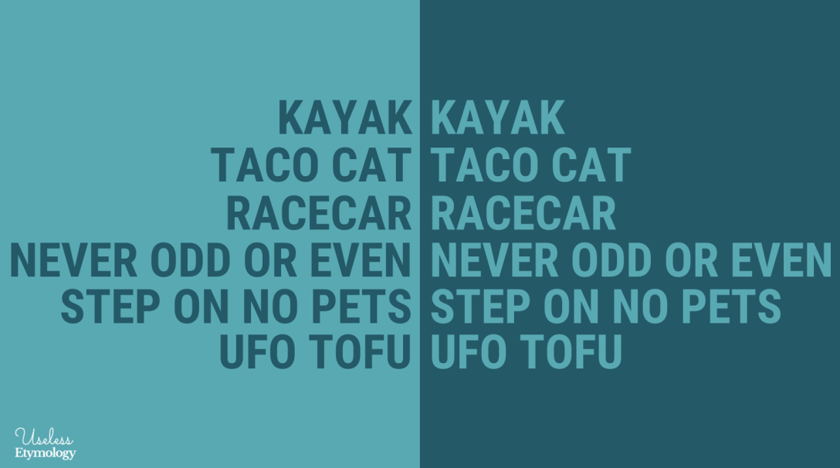
Activity 1 – Is it a palindrome
A palindrome is a word, number, phrase, or other sequence of characters which reads the same backward as forward, such as madam, racecar, etc.
There are also numeric palindromes, including date/time stamps using short digits 11/11/11 11:11 and long digits 02/02/2020.
Sentence-length palindromes may be written when allowances are made for adjustments to capital letters, punctuation, and word dividers, such as "A man, a plan, a canal, Panama!".
Write a function is_palindrome(), which receives a single word, in a string variable word as its sole input parameter.
It should return True if the string in question is a palindrome.
And False otherwise.

Slide 17
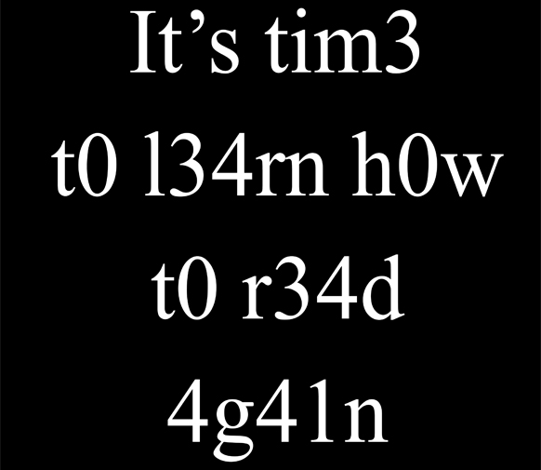
Activity 2 – 1337 speak translators
Leet (or "1337") is a system of modified spellings used primarily on the Internet. It often uses character replacements in ways that play on the similarity of their glyphs via reflection or other resemblance.
Leet speak replaces the letters I with 1, the letters Z with 2, the letters E with 3, the letters A with 4, the letters S with 5, the letters T with 7, the letters B with 8, the letters O with 0.
For instance, the English sentence "HELLO THERE, HOW ARE YOU?" will write in leet speak as "H3LL0 7H3R3, H0W 4R3 Y0U?".

Slide 18
Activity 2 – 1337 speak translators
Leet (or "1337") is a system of modified spellings used primarily on the Internet. It often uses character replacements in ways that play on the similarity of their glyphs via reflection or other resemblance.
Leet speak replaces the letters I with 1, the letters Z with 2, the letters E with 3, the letters A with 4, the letters S with 5, the letters T with 7, the letters B with 8, the letters O with 0.
For instance, the English sentence "HELLO THERE, HOW ARE YOU?" will write in leet speak as "H3LL0 7H3R3, H0W 4R3 Y0U?".
Write a function eng_to_leet().
It receives a single parameter, eng_str, which corresponds to a sentence in English, written in capital letters.
It returns the equivalent sentence in leet speak.
Do so by modifying the letters with numbers, by following the rules we defined earlier.

Slide 19
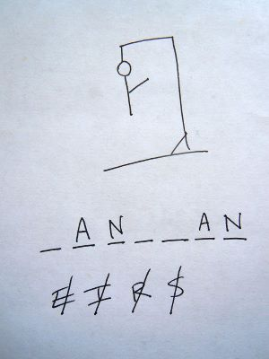
Activity 3 – Hangman
The hangman is a game where one player thinks of a word, phrase or sentence and the other(s) tries to guess it by suggesting letters within a certain number of guesses.

Slide 20
Activity 3 – Hangman
Write a function hangman(), which receives four arguments:
hidden_word: a hidden word that the player must guess. Normally, this word would be hidden from the player, but we will show it for now, as a way to check our function hangman() works as intended.
proposed_letter: a single letter string, corresponding to a letter, which the player just proposed.
letters_list: a list of letters, containing the previous propositions made by the user.
This function returns three arguments:
revealed_word: The revealed word consists of the hidden_word, where the letters in the parameters proposed_letter and letters_list are shown. the other letters are replaced with star (*) characters.
For instance, if the parameters are
hidden_word = "bulbasaur",
proposed_letter = "u",
and letters_list = ["e", "a", "r"] are passed to the function hangman(),
Then it will return revealed_word = "*u**a*aur". Note that all occurrences of the proposed letters should be displayed.

Slide 21
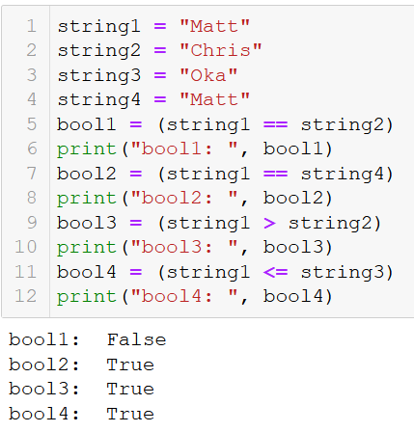
Boolean operations on strings
Boolean operations on strings:
As you have seen earlier, we can use == (resp. !=) to check if two strings are identical (resp. different).
The comparisons also work on strings but with a different behavior.
The comparison operators (>, <, >=, <=) can also be used.
These comparison operators compare the alphabetical order between strings.

Slide 22
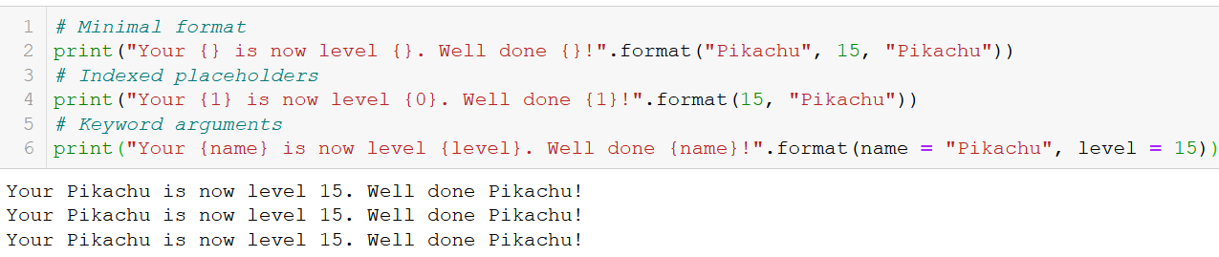
Strings formatting with format()
We have seen how the format() method could be used to insert the values of some variables inside a string.
Turns out it can operate with indexes or even keywords.
Some arguments can also be passed to the placeholders {}, for more advanced formatting, but this is out of the scope of this class.
https://docs.python.org/3/library/string.html#formatstrings

Slide 23
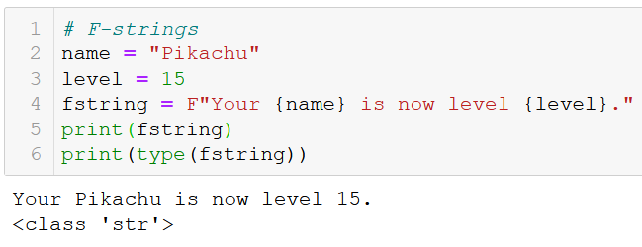
A quick word on F-strings
A quick word on F-Strings:
The latest versions of Python (3.7+) came with F-strings: the F-strings are strings, but they are preceded by the letter F, to indicate that it contains some placeholders {} to be formatted.
In F-strings, you can directly pass some variable names inside the placeholders, which is simpler than using format().

Slide 24
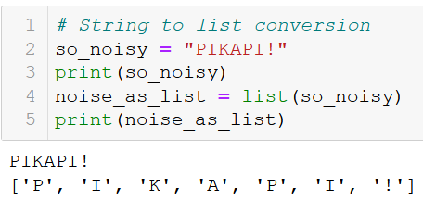
Lists ←→ Strings conversions
Because lists and strings are roughly the same thing, it is sometimes convenient to convert one into the other.
It is sometimes more useful to convert one into the other to get rid of the immutability property of strings!
Str → List: Easily done with list(), which gives a list of characters.

Slide 25
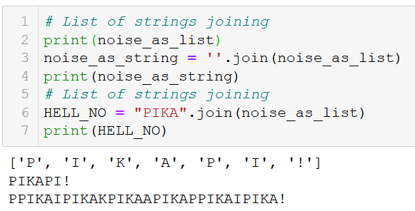
Lists ←→ Strings conversions
The converse operations is somewhat more difficult.
List → Str: done with the join() method, often applied on an empty string “”.
Applying it on something else than an empty string leads to… interesting results.

Slide 26
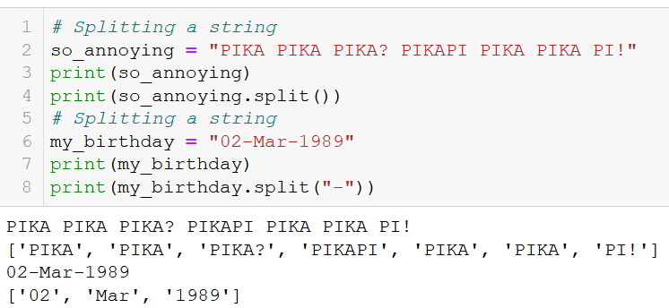
Splitting a string into a list of strings
If needed, you can split a large string into a list of smaller ones, with the split() method.
By default, it returns a list of the different words in the string, using whitespaces as separators.
You can also specify a substring to use as a separator instead of whitespaces.
Convenient for dates (14/10/2020), times (14:52:26), etc.

Slide 27
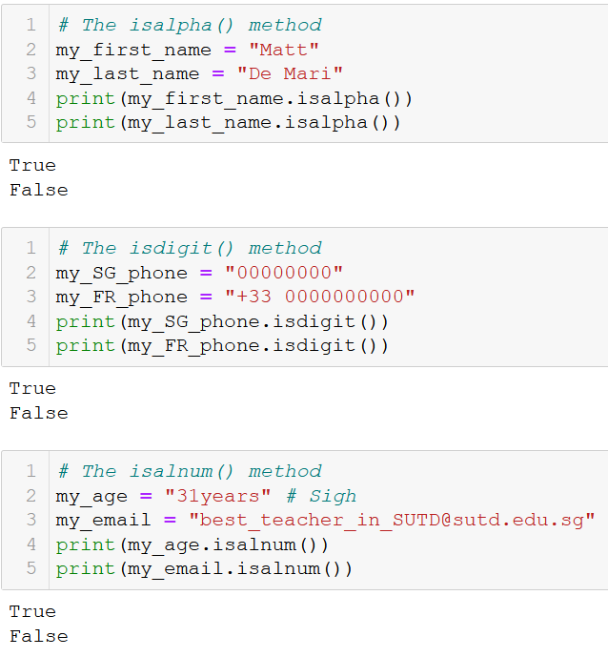
Characters types check in strings
You can check for characters types in a string with 3 methods.
isalpha() returns True is characters are letters only; and False otherwise.
isdigit() returns True if the characters are digits only; and False otherwise.
isalnum() returns True if the characters are letters and digits only; and False otherwise.

Slide 28
Activity 4 - Create password from sentence
A passphrase is a sentence which can be used to create passwords that are difficult to crack and easy to memorize.
The user simply needs to create a memorable sentence containing multiple words.
Later on, the user will assemble a password by alternating the first letter of each word in the passphrase and the number of characters in it. In addition, add the special characters when they appear.
For instance, the sentence
"I used to be an adventurer like you until I took an arrow to the knee“
can be used to generate the following password
"I1u4t2b2a2a10l4y3u5I1t4a2a5t2t3k4“
Write a function generate_password(), which receives a passphrase as its only parameter, and returns a single output, consisting of a string generated according to the method we described.

Slide 29
Activity 5 – Password checker
Write a function password_check(), which receives a single parameter, password, consisting of a string variable.
This function returns a boolean with value True if:
the password has at least 8 characters,
and the password contains at least one letter
and the password contains at least one number,
and the password contains at least one special character (i.e. a non-number, non-letter character).
If any of these conditions is not met, the password is deemed invalid (not strong enough) and the function returns False.

Slide 30
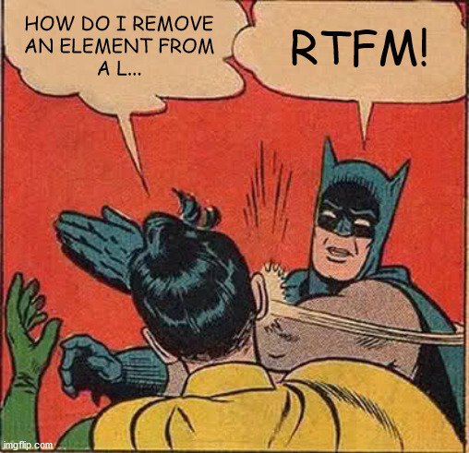
As usual, RTFM!
The string objects in Python have many more built-in methods and functions you could use.
We do not expect you to know about all these methods and functions, nor about how they work in detail.
Just know where to find the information if you need it.
And do not be afraid to read the Python documentation!
String type documentation (RTFM!) https://docs.python.org/2/library/string.html

Slide 31
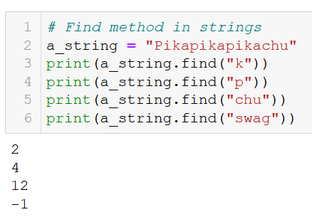
The find() method
The strings come with an additional method, called find(), which looks for a character or substring inside another string.
It returns the index of the first appears of said character or substring inside the string.
If the character or substring does not appear, it returns -1.

Slide 32
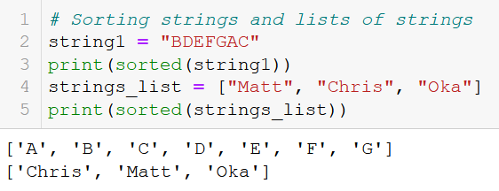
Sorting strings and lists of strings
We have seen earlier how the sorted() function could be used to sort a list of strings alphabetically.
It can also be applied on a single string. This produces a list of strings, this time reorganized in alphabetical order.

Slide 33
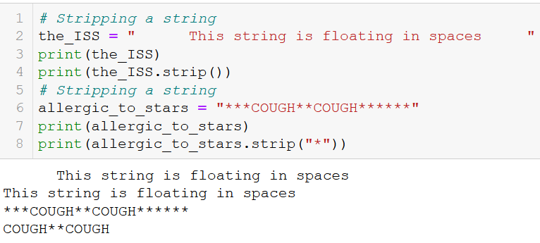
Additional: functions, strip-cleaning a string
Strip-cleaning a string removes the extra spaces, if any, at the beginning and end of a string.
If a substring is passed to the split() method, it will remove the occurrences of these extra characters at the beginning and end of the string.

Slide 34
Once more for those in the back
The string objects in Python have many more built-in methods and functions you could use.
We do not expect you to know about all these methods and functions, nor about how they work in detail.
Just know where to find the information if you need it.
And do not be afraid to read the Python documentation!
String type documentation (RTFM!) https://docs.python.org/2/library/string.html

Slide 35
Conclusion (Chapter 14)
What is a string? How are they related to lists?
How to index, slice and traverse a string?
What is the immutability property of strings?
What are common booleans on strings?
A complete description of printing and formatting with strings.
How ton convert strings to lists and vice-versa?
What are more advanced operations on strings, such as splitting, stripping, character checking, sorting, etc.? (RTFM!)

Slide 36



Please download and install the Slido app on all computers you use
What is the output produced by this code?
ⓘ Start presenting to display the poll results on this slide.

Slide 37
Please download and install the Slido app on all computers you use
What is the output of this code?
ⓘ Start presenting to display the poll results on this slide.

Slide 38
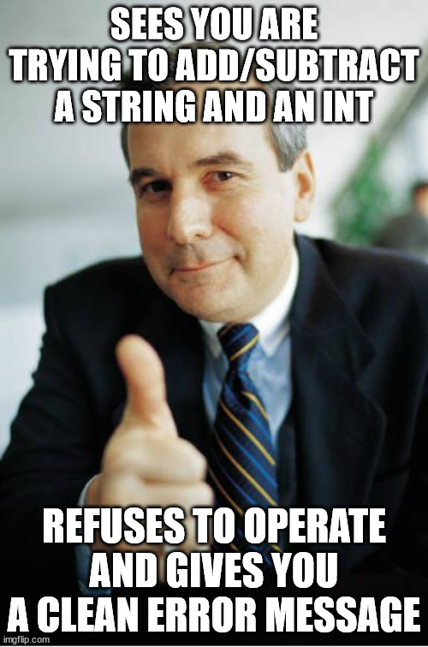


Slide 39
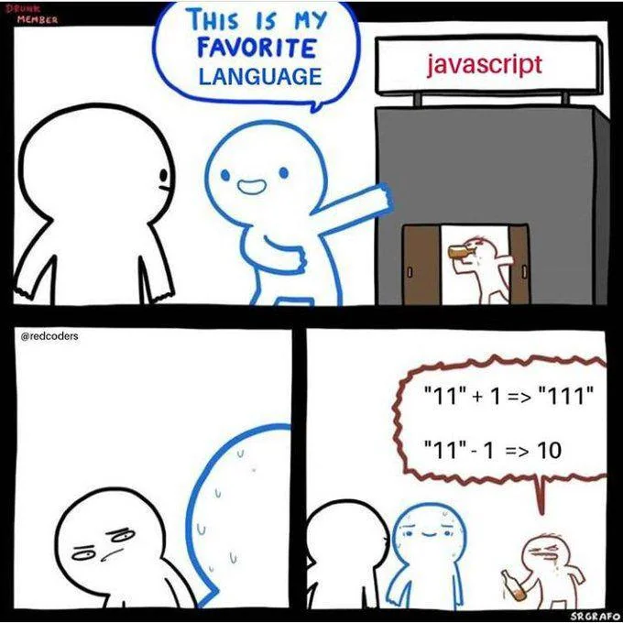

Meanwhile…

Slide 40
Please download and install the Slido app on all computers you use
Which slicing should we use on line 2 to produce a True on line 3?
ⓘ Start presenting to display the poll results on this slide.

Slide 41
Please download and install the Slido app on all computers you use
What will be printed?
ⓘ Start presenting to display the poll results on this slide.

Slide 42
Please download and install the Slido app on all computers you use
Given a string s = "MatthieuDeMari", which of these will produce a True?
ⓘ Start presenting to display the poll results on this slide.

